Slide 1
Building up an implementation
The proposed process of describing a real binary object through the lens of the specification items

Slide 2
Session Outline
Using the TIFF baseline format models from previous session, we’re going to take a binary object and see how we can populate an implementation object
We’ll abstract the TIFF models, and see how we can model the interplay between specification derived information and implementation derived information, and onto Compositions
We’ll also see how we could use this model to troubleshoot poorly made/formed files

Slide 3
A comment on abstraction
We’re using TIFF because it allows us model some the conditions we expect to find in the real world.
Its useful to consider the spec model as a a derived model for any format, not specifically a TIFF model
This allows us to explore how the proposed model allows us to build format “objects” out of specification aspects, and also from things we find in implementations that are important to us

Slide 4

An Example File
Jhove
Exiftool
Other tag readers
https://github.com/jaygattuso/iPres2014-format-workshop/tree/master/example_tiff

Slide 5
ExifToolVersion = 9.69
FileName = sample-1.tif
Directory = C:/Documents and Settings/gattusoj/Desktop
FileSize = 7910
FileModifyDate = 1407798004
FileAccessDate = 1407799874
FileCreateDate = 1407798004
FilePermissions = 33206
FileType = TIFF
MIMEType = image/tiff
ExifByteOrder = II
+ [IFD0 directory with 20 entries]
| 0) SubfileType = 0
| - Tag 0x00fe (4 bytes, int32u[1]):
| 1d20: 00 00 00 00 [....]
| 1) ImageWidth = 256
| - Tag 0x0100 (4 bytes, int32u[1]):
| 1d2c: 00 01 00 00 [....]
| 2) ImageHeight = 256
| - Tag 0x0101 (4 bytes, int32u[1]):
| 1d38: 00 01 00 00 [....]
| 3) BitsPerSample = 8 8 8 8
| - Tag 0x0102 (8 bytes, int16u[4]):
| 1e0c: 08 00 08 00 08 00 08 00 [........]

Slide 6
| 4) Compression = 5
| - Tag 0x0103 (2 bytes, int16u[1]):
| 1d50: 05 00 [..]
| 5) PhotometricInterpretation = 2
| - Tag 0x0106 (2 bytes, int16u[1]):
| 1d5c: 02 00 [..]
| 6) StripOffsets = 8 211 414 705 1007 1362 1768 2168 2617 3072 3506 3918 4318 4723 5109 5495 5897 6286 6593 6925 7128 7331
| - Tag 0x0111 (88 bytes, int32u[22]):
| 1e14: 08 00 00 00 d3 00 00 00 9e 01 00 00 c1 02 00 00 [................]
| 1e24: ef 03 00 00 52 05 00 00 e8 06 00 00 78 08 00 00 [....R.......x...]
| 1e34: 39 0a 00 00 00 0c 00 00 b2 0d 00 00 4e 0f 00 00 [9...........N...]
| 1e44: de 10 00 00 73 12 00 00 f5 13 00 00 77 15 00 00 [....s.......w...]
| 1e54: 09 17 00 00 8e 18 00 00 c1 19 00 00 0d 1b 00 00 [................]
| 1e64: d8 1b 00 00 a3 1c 00 00 [........]
| 7) SamplesPerPixel = 4
| - Tag 0x0115 (2 bytes, int16u[1]):
| 1d74: 04 00

Slide 7
8) RowsPerStrip = 12
| - Tag 0x0116 (4 bytes, int32u[1]):
| 1d80: 0c 00 00 00 [....]
| 9) StripByteCounts = 203 203 291 302 355 406 400 449 455 434 412 400 405 386 386 402 389 307 332 203 203 114
| - Tag 0x0117 (88 bytes, int32u[22]):
| 1e6c: cb 00 00 00 cb 00 00 00 23 01 00 00 2e 01 00 00 [........#.......]
| 1e7c: 63 01 00 00 96 01 00 00 90 01 00 00 c1 01 00 00 [c...............]
| 1e8c: c7 01 00 00 b2 01 00 00 9c 01 00 00 90 01 00 00 [................]
| 1e9c: 95 01 00 00 82 01 00 00 82 01 00 00 92 01 00 00 [................]
| 1eac: 85 01 00 00 33 01 00 00 4c 01 00 00 cb 00 00 00 [....3...L.......]
| 1ebc: cb 00 00 00 72 00 00 00 [....r...]
| 10) XResolution = 96.012 (96012/1000)
| - Tag 0x011a (8 bytes, rational64u[1]):
| 1ec4: 0c 77 01 00 e8 03 00 00 [.w......]
| 11) YResolution = 96.012 (96012/1000)
| - Tag 0x011b (8 bytes, rational64u[1]):
| 1ecc: 0c 77 01 00 e8 03 00 00 [.w......]

Slide 8
| 12) PlanarConfiguration = 1
| - Tag 0x011c (2 bytes, int16u[1]):
| 1db0: 01 00 [..]
| 13) ResolutionUnit = 2
| - Tag 0x0128 (2 bytes, int16u[1]):
| 1dbc: 02 00 [..]
| 14) Software = Adobe ImageReady
| - Tag 0x0131 (17 bytes, string[17]):
| 1ed4: 41 64 6f 62 65 20 49 6d 61 67 65 52 65 61 64 79 [Adobe ImageReady]
| 1ee4: 00 [.]
| 15) Predictor = 2
| - Tag 0x013d (2 bytes, int16u[1]):
| 1dd4: 02 00 [..]
| 16) ExtraSamples = 2
| - Tag 0x0152 (2 bytes, int16u[1]):
| 1de0: 02 00 [..]
| 17) Exif_0x5110 = 1
| - Tag 0x5110 (1 bytes, int8u[1]):
| 1dec: 01 [.]
| 18) Exif_0x5111 = 0
| - Tag 0x5111 (4 bytes, int32u[1]):
| 1df8: 00 00 00 00 [....]
| 19) Exif_0x5112 = 0
| - Tag 0x5112 (4 bytes, int32u[1]):
| 1e04: 00 00 00 00

Slide 9
ByteOrder: little_endian
CompressionScheme: LZW
ImageWidth: 256
ImageHeight: 256
ColorSpace: RGB
ReferenceBlackWhite: 0, 255, 0, 255, 0, 255
ScanningSoftware: Adobe ImageReady
Orientation: normal
SamplingFrequencyUnit: inch
XSamplingFrequency: 96.012
YSamplingFrequency: 96.012
BitsPerSample: 8, 8, 8, 8
BitsPerSampleUnit: integer
SamplesPerPixel: 4
ExtraSamples: unassociated alpha
Jhove gives us about 30 bits of data, (excluding the 3 it doesn't understand.)
The file tells us it includes only 20.
InfoMessage: Unknown TIFF IFD tag: 20752
Offset: 7660
InfoMessage: Unknown TIFF IFD tag: 20753
Offset: 7672
InfoMessage: Unknown TIFF IFD tag: 20754
Offset: 7684

Slide 10
Tools.
We frequently look at files through tools built from the creators eyes / interpretation of the standard
This includes use of units (Bits? Bytes?, Hex? Dec?) and labels
We generally accept the tools as truthful (in the main correctly)
We rarely go the bitstream and standards for a first hand look at whats actually going on

Slide 11
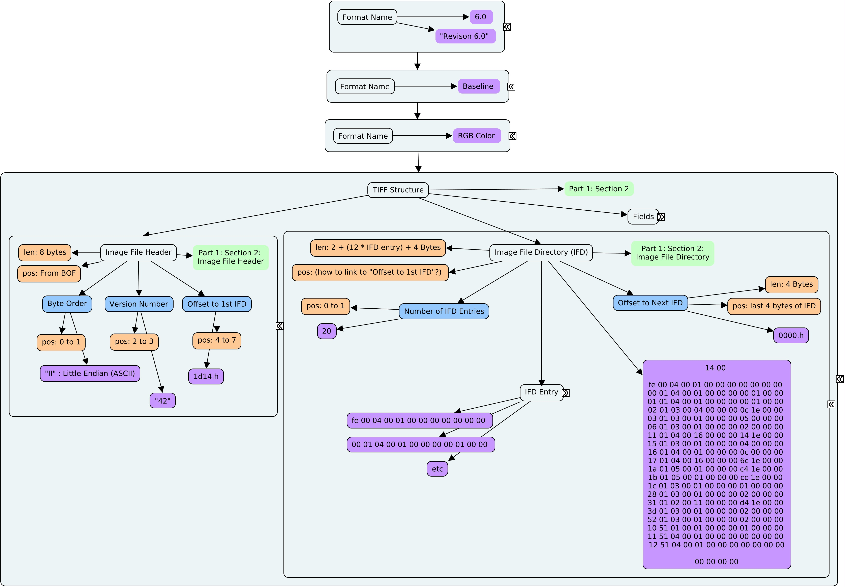
Lets look at an Imp
Full TIF Baseline Imp.cmap
This is just the structural part

Slide 12
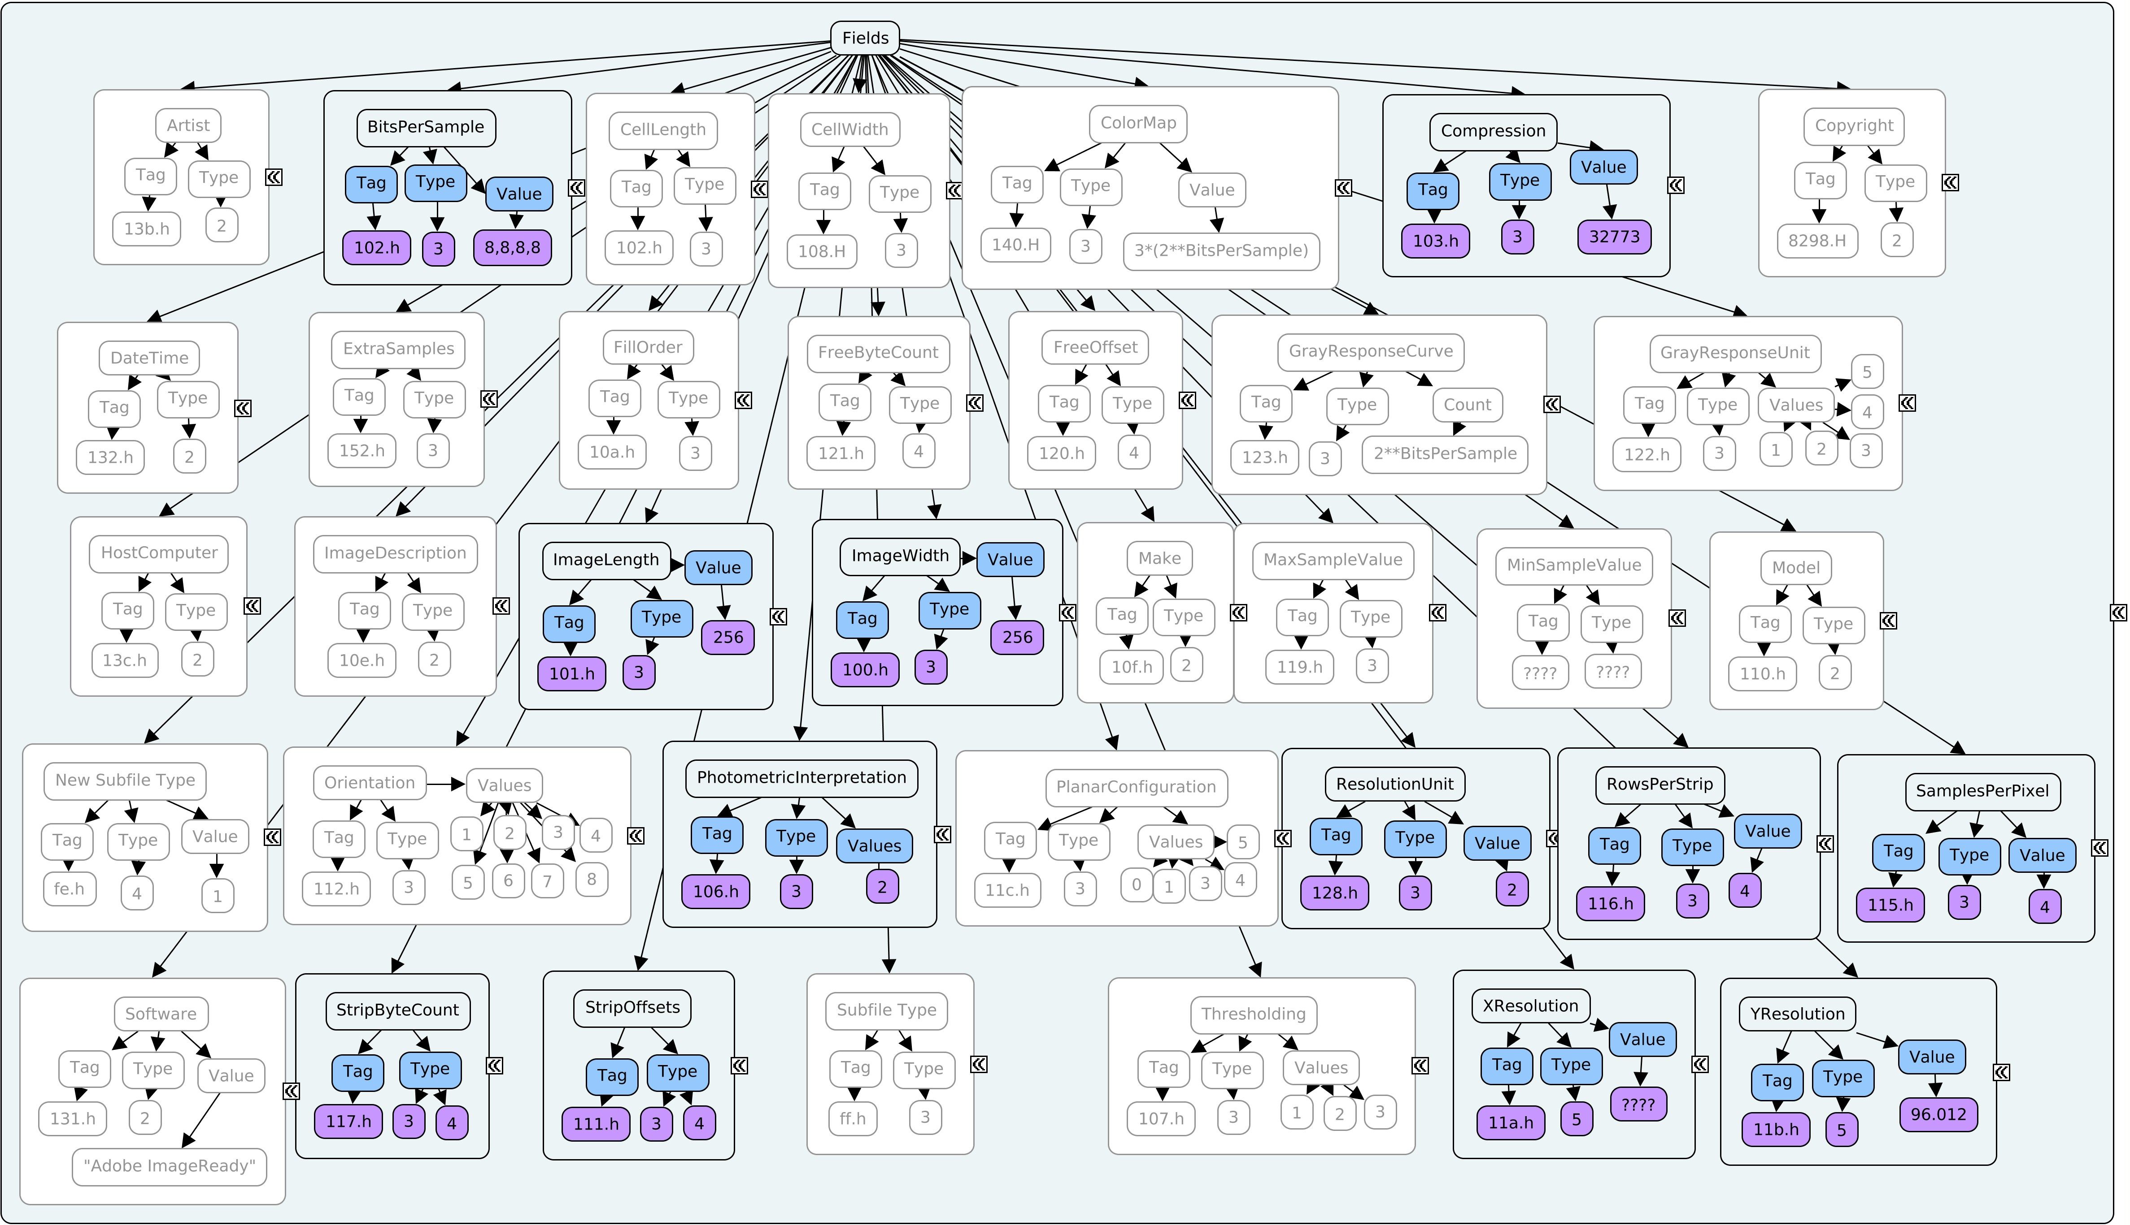
Example 1: A pure Spec derived Imp
a RGB Baseline Imp

Slide 13
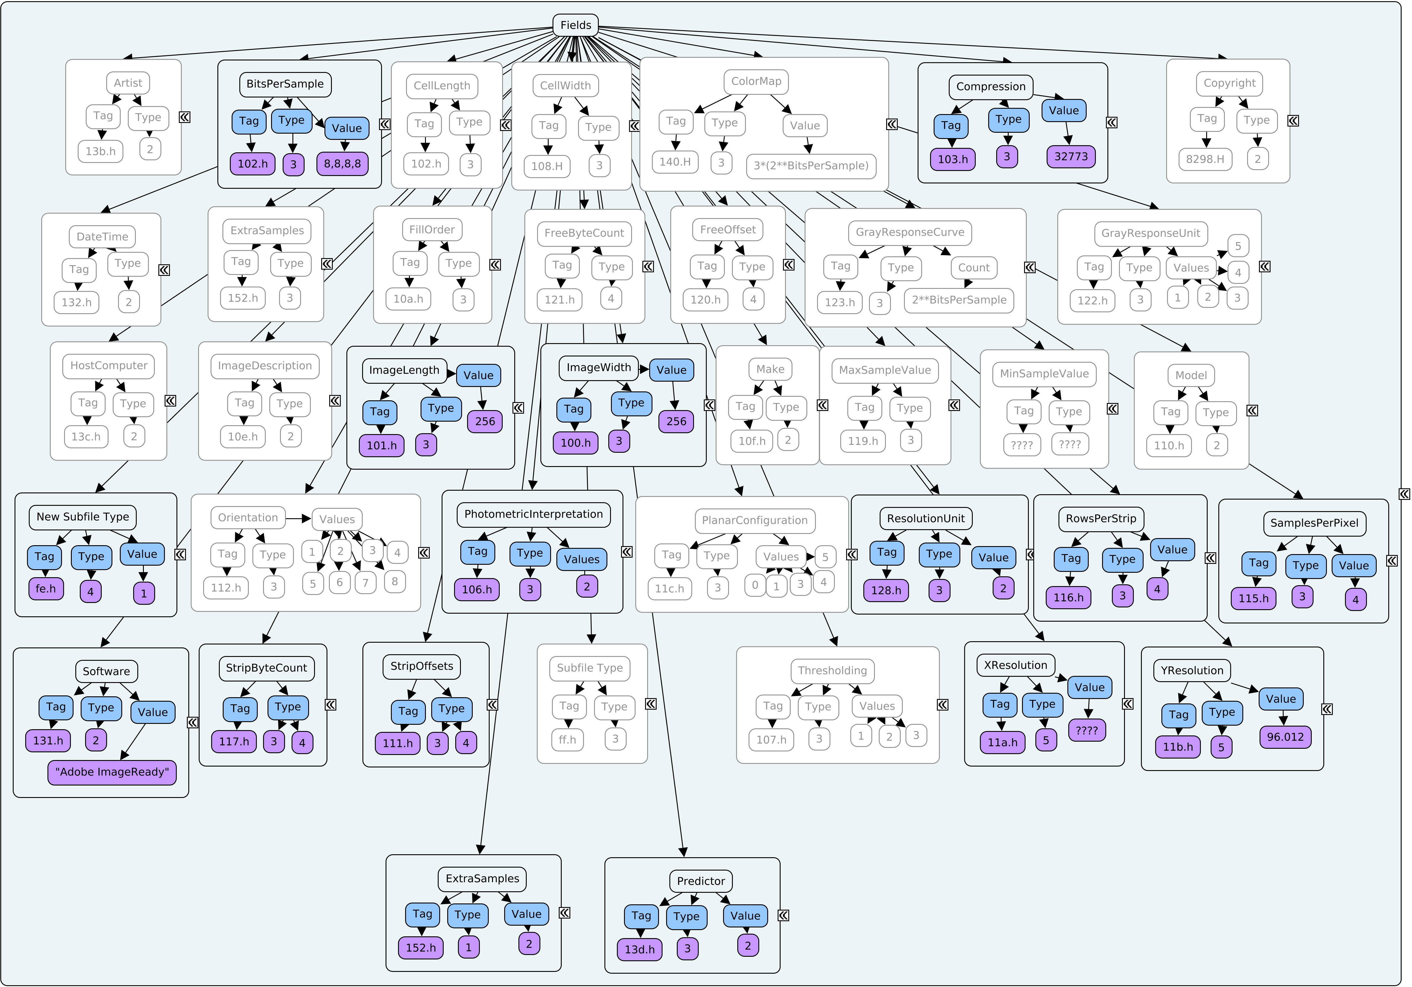
Example 2: A mainly Spec derived format
a RGB Baseline Imp with extended tags

Slide 14
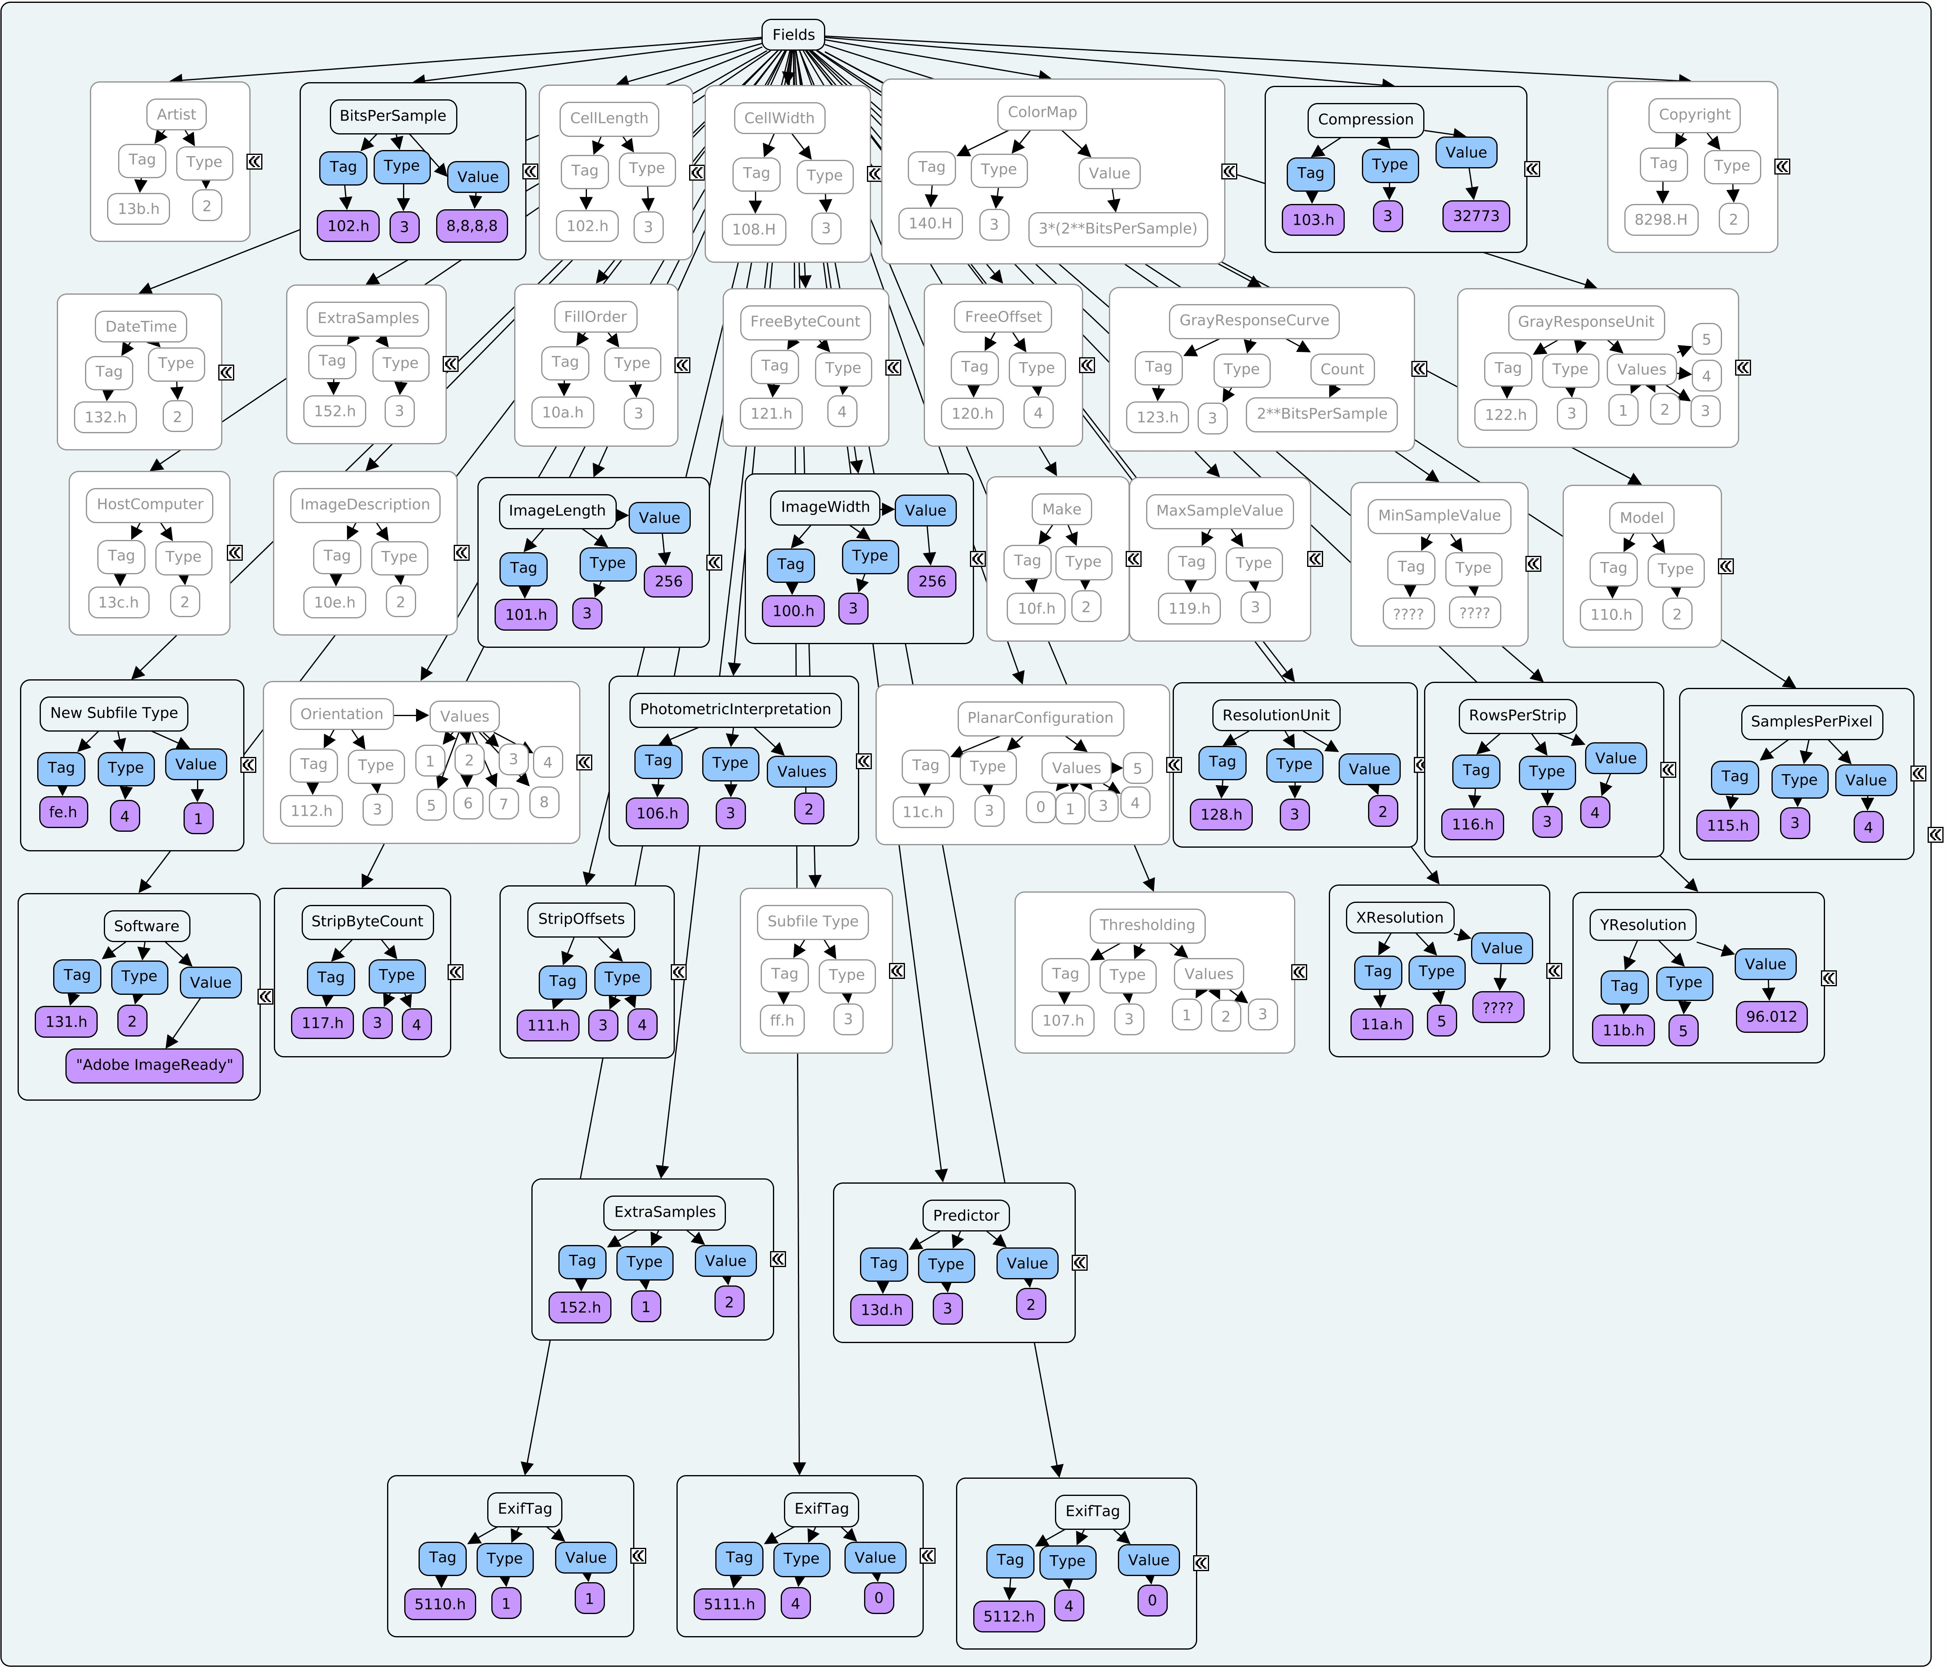
Example 3: A partially Spec derived format
We just defined 3 different TIFF variants that we could test for.

Slide 15
Lets look at the whole Imp
Full TIF Baseline Imp+fields.cmap

Slide 16
Example 4: Building up a composition object
Remember that the comp is the highest order object, and is what we consider the “format” at what ever level we are looking at.
Its the sum of the Spec and Imp objects that we've created, and the sources / community text we've associated

Slide 17
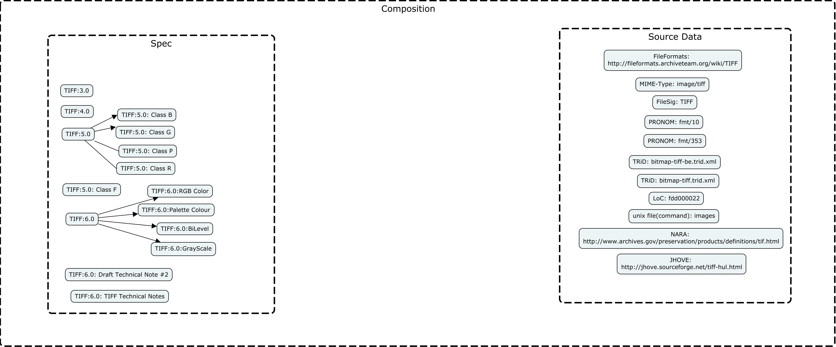

Slide 18
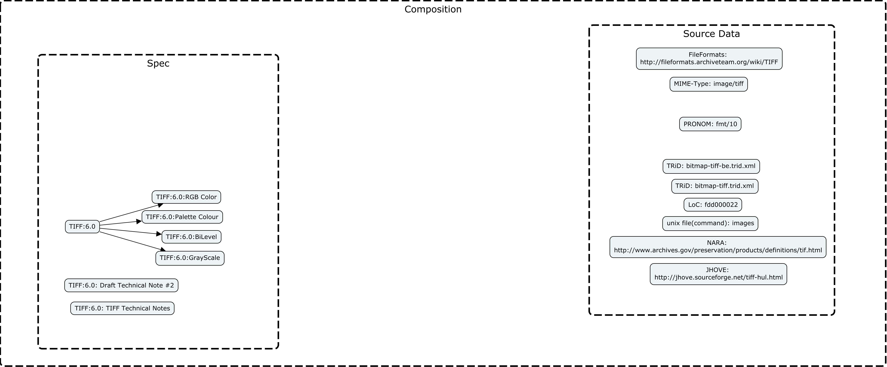

Slide 19
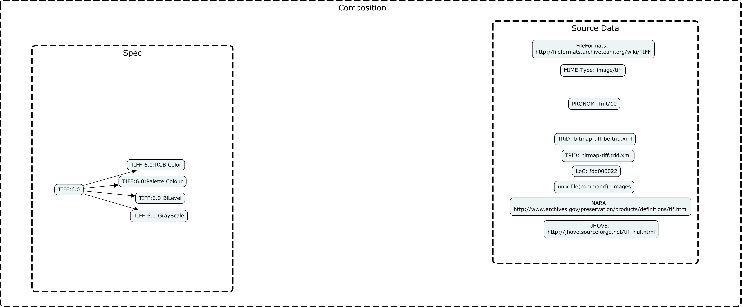

Slide 20
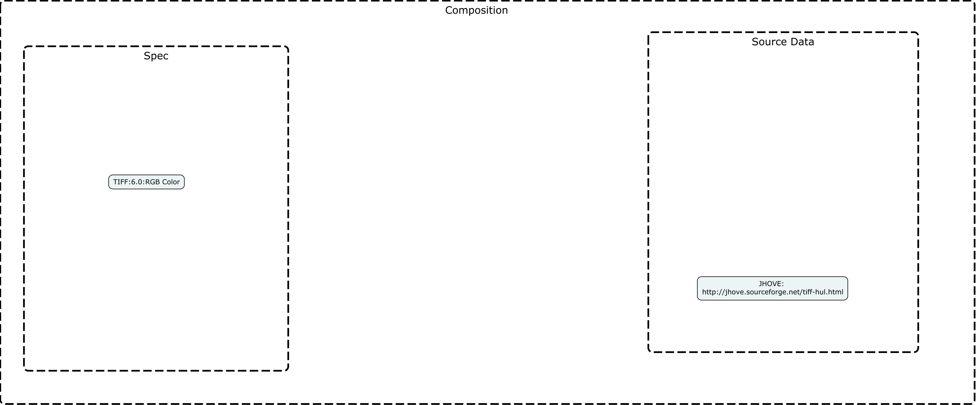

Slide 21
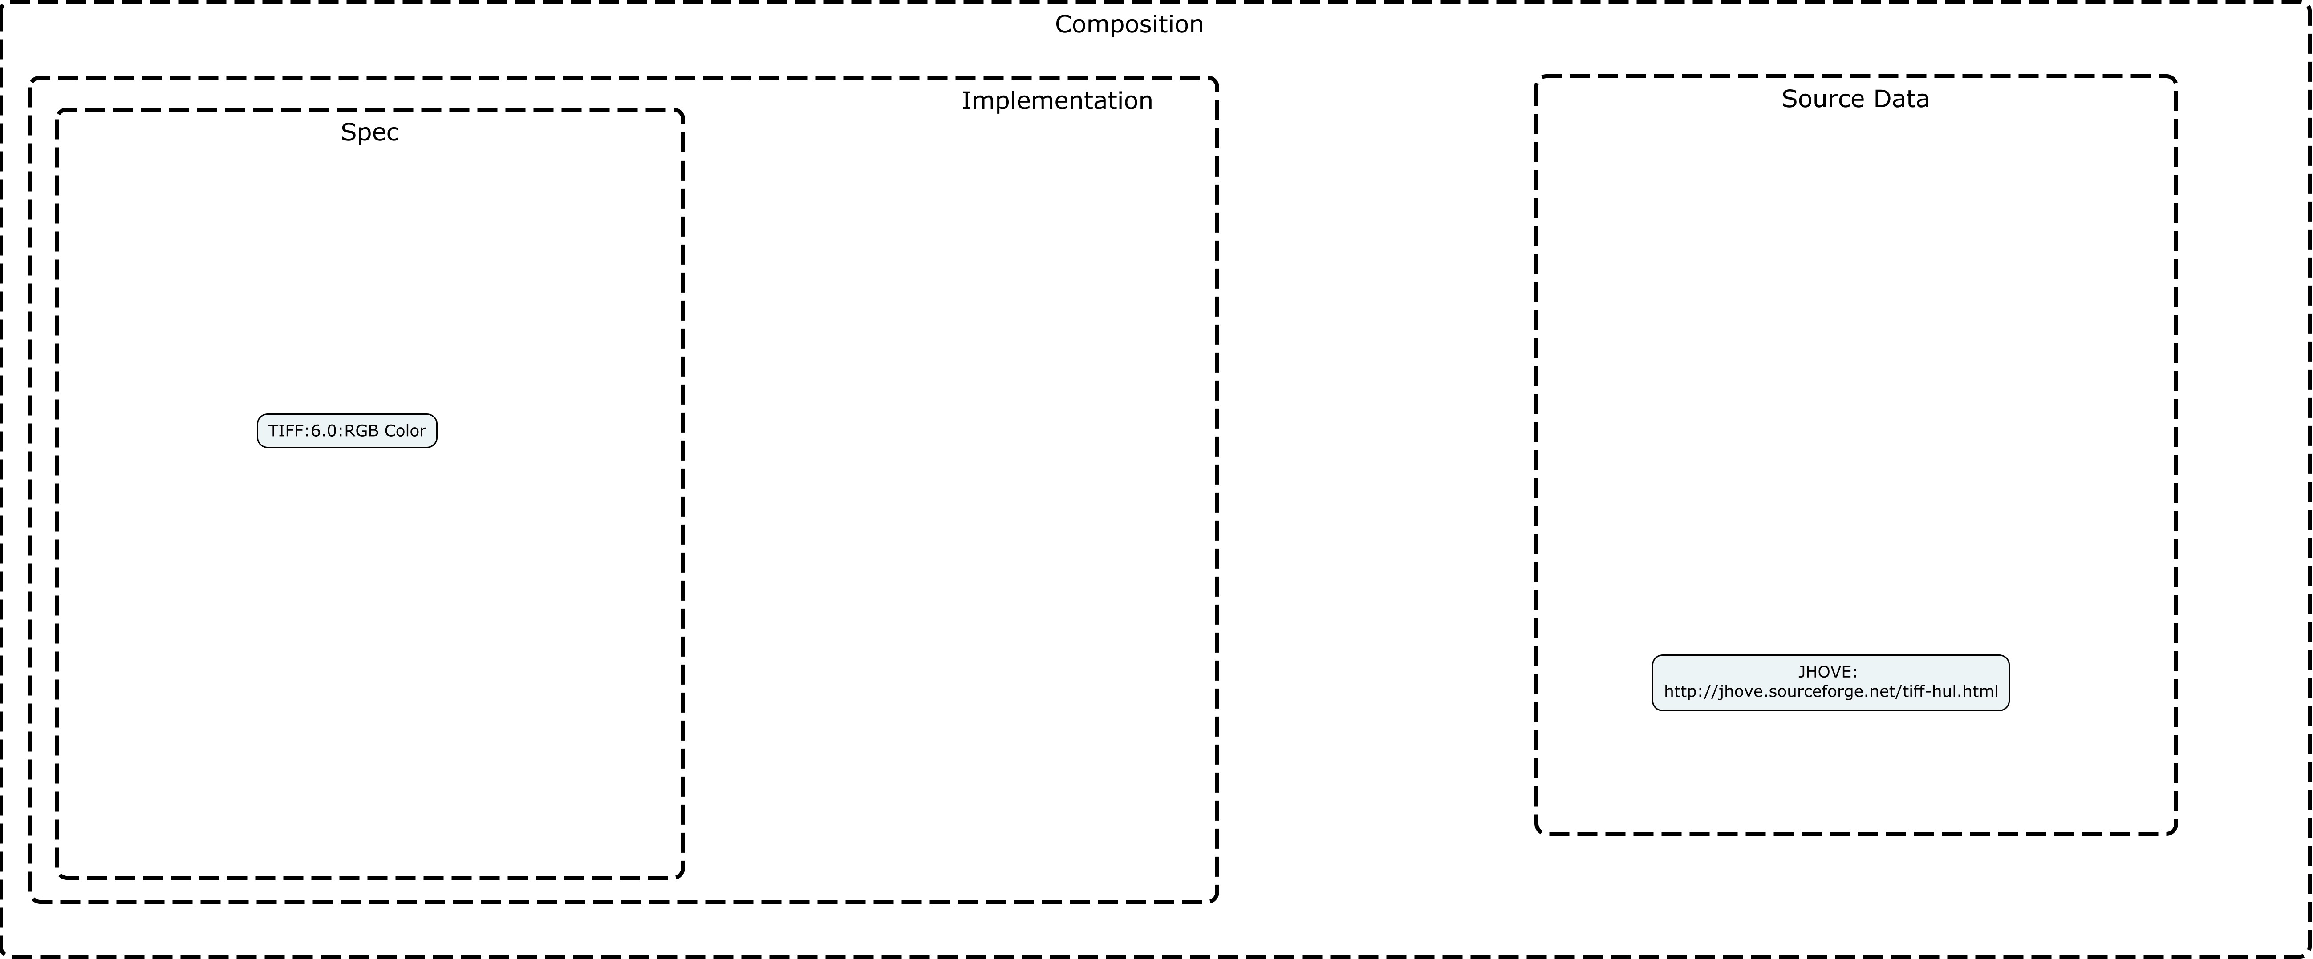

Slide 22
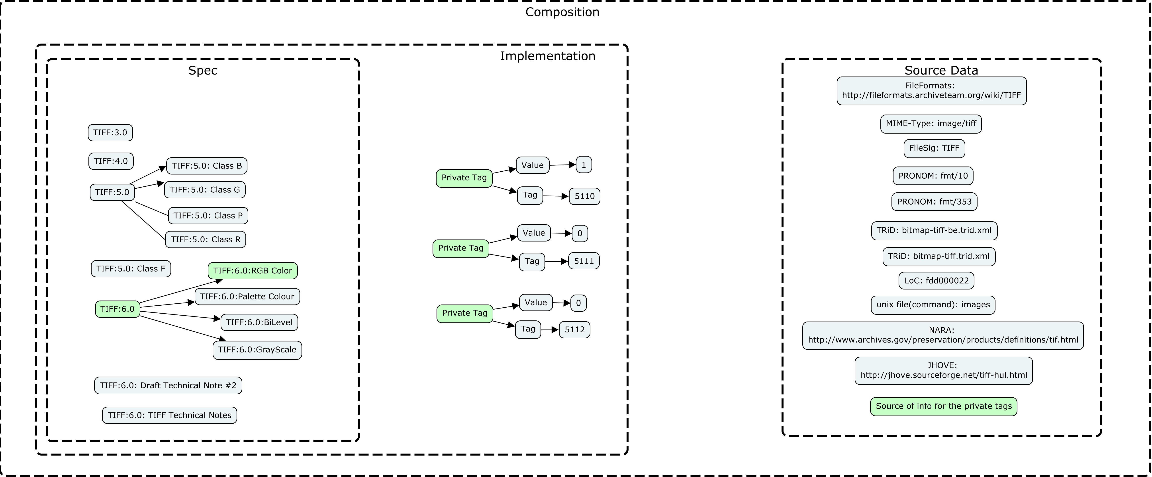

Slide 23
Example 5: How we might interact with a binary object that’s interesting
A Tiff that fails JHOVE “well-formed” – less fixable…
Closer look at MyTif.tif
  Jhove report

Slide 24
Example 6: Based on a True Story
tiff tags fix.docx

Slide 25
Reflection: Is addressing structural deficiencies “Preservation” or QC?
  Is fixing structure an acceptable change?

Slide 26
Summary
We’ve seen how we might start to use the format derived model to assess files, and assign deeper format type assertions
We’re able to meaningfully navigate a real binary object, referencing the formal specification, without having to wade through heaps of files…
We’re able to quickly find and inspect structural parts of binary objects, and apply the format spec to the binary stream

